Slide 1
Accident prediction
How can we lower the amount of serious incidents

Slide 2
Data
Found on statbel. Statistical service of the Belgian government
Multiple datapoints collected from accidents in 2019

Slide 3
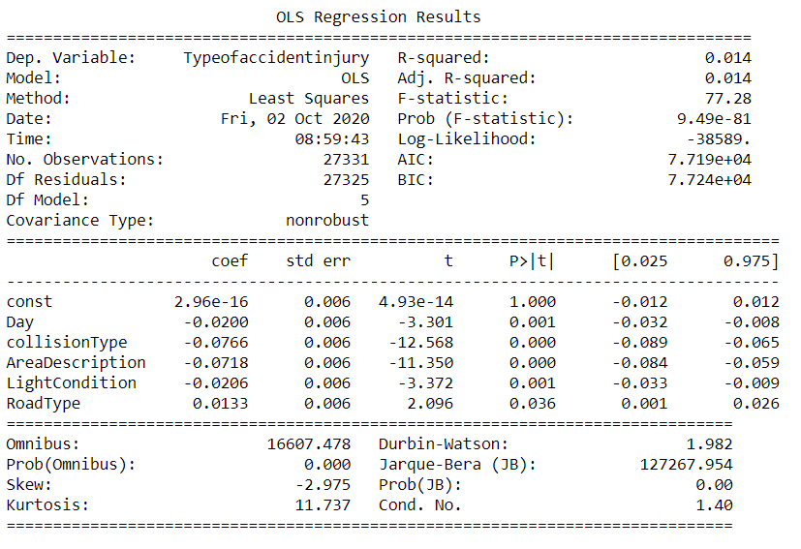
Conclusion
Low prediction power (R^2)
7 parameters having an impact on accident injury level

Slide 4
Discussion
What parameters have an impact on type of injury after an accident?
How to lower the amount of serious injuries?
On which algorithm can this conclusion be plugged in?
How can policies have an impact on the numbers?

